Slide 1


AWSOME DAY
15
KRANTHI
AMIT SUDHA
INDRANI

Slide 2
AWS Elasticity and Management Tools
© 2018, Amazon Web Services, Inc. or its Affiliates. All rights reserved.

Slide 3





Triad of Services
Elastic Load Balancing
Latency
Utilization
Auto Scaling group
Auto Scaling
CloudWatch
© 2018, Amazon Web Services, Inc. or its Affiliates. All rights reserved.

Slide 4
Triad of Services
Elastic Load
Balancing
Latency
Utilization
Auto Scaling group
Execute AS Policy
Auto Scaling
© 2018, Amazon Web Services, Inc. or its Affiliates. All rights reserved.

Slide 5
Triad of Services
Elastic Load Balancing
Latency
Utilization
Auto Scaling group
Auto Scaling
CloudWatch
© 2018, Amazon Web Services, Inc. or its Affiliates. All rights reserved.

Slide 6
Elastic Load Balancing
Distributes traffic across multiple EC2 instances, in multiple Availability Zones
Supports health checks to detect unhealthy
Amazon EC2 instances
Supports the routing and load balancing of HTTP, HTTPS, SSL, and TCP traffic to Amazon EC2 instances
Elastic Load Balancing
© 2018, Amazon Web Services, Inc. or its Affiliates. All rights reserved.

Slide 7



Classic Load Balancer – How It Works
Register instances with your load balancer.
load balancer
X
Availability Zone A
Availability Zone B
© 2018, Amazon Web Services, Inc. or its Affiliates. All rights reserved.

Slide 8



































Application Load Balance – How It Works
Register instances as targets in a target group, and route traffic to a target group.
load balancer
Rule
Listener
Rule
Listener
Rule
Target Target
Target
Target
Target
Target
Target
Target Group
Health Check
Target Group /api
Health Check
Target Group /mobile
Health Check
© 2018, Amazon Web Services, Inc. or its Affiliates. All rights reserved.

Slide 9
Amazon CloudWatch
A monitoring service for AWS cloud resources and the applications you run on AWS
Visibility into resource utilization, operational performance, and overall demand patterns
Custom application-specific metrics of your own
Accessible via AWS Management Console, APIs, SDK, or CLI
Amazon
CloudWatch
© 2018, Amazon Web Services, Inc. or its Affiliates. All rights reserved.

Slide 10
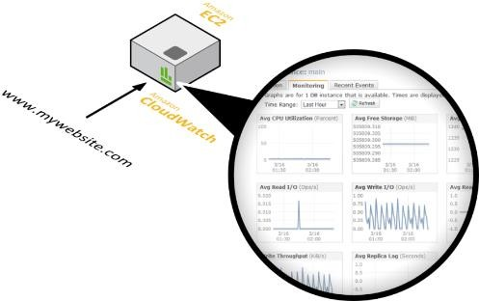

Amazon CloudWatch Facts
Monitor other AWS resources
View graphics and statistics
Set Alarms
© 2018, Amazon Web Services, Inc. or its Affiliates. All rights reserved.

Slide 11
























Amazon CloudWatch Architecture
Amazon CloudWatch
AWS resources that support CloudWatch
Amazon CloudWatch Alarm
SNS Email Notification
CPUUtilization
StatusCheckFailed
PageViewCount
Available Statistics
Custom Application- Specific Metrics
CloudWatch Metrics
Auto Scaling
AWS Management Console
Statistics Consumer
© 2018, Amazon Web Services, Inc. or its Affiliates. All rights reserved.

Slide 12

Auto Scaling
Scale your Amazon EC2 capacity automatically
Well-suited for applications that experience variability in usage
Available at no additional charge
Auto
Scaling
© 2018, Amazon Web Services, Inc. or its Affiliates. All rights reserved.

Slide 13

Launch Configurations
A launch configuration is a template that an Auto Scaling
group uses to launch EC2 instances.
When you create a launch configuration, you can specify:
AMI ID
Instance type
Key pair
Security groups
Block device mapping
User data
© 2018, Amazon Web Services, Inc. or its Affiliates. All rights reserved.

Slide 14





Auto Scaling Groups
Contain a collection of EC2 instances that share similar characteristics.
Instances in an Auto Scaling group are treated as a logical grouping for the purpose of instance scaling and management.
Auto Scaling group
Minimum size
Scale out as needed
Desired capacity
Maximum size
© 2018, Amazon Web Services, Inc. or its Affiliates. All rights reserved.

Slide 15







Auto Scaling Basic Lifecycle
Scale Out
Launch Instance
instances
Auto Scaling group
Scheduled Event
Amazon CloudWatch
© 2018, Amazon Web Services, Inc. or its Affiliates. All rights reserved.

Slide 16

Auto Scaling Basic Lifecycle
Attach to Group
Scale Out
Launch Instance
instances
Auto Scaling group
Scheduled Event
Amazon CloudWatch
© 2018, Amazon Web Services, Inc. or its Affiliates. All rights reserved.

Slide 17




Auto Scaling Basic Lifecycle
instances
Auto Scaling group
Detach from Group
Scale In
Amazon
CloudWatch
Scheduled
Event
© 2018, Amazon Web Services, Inc. or its Affiliates. All rights reserved.

Slide 18
Auto Scaling Basic Lifecycle
instances
Auto Scaling group
Detach from Group
Terminate Instance
X
Scale In
Amazon
CloudWatch
Scheduled
Event
© 2018, Amazon Web Services, Inc. or its Affiliates. All rights reserved.

Slide 19
REAL TIME EXAMPLE
© 2018, Amazon Web Services, Inc. or its Affiliates. All rights reserved.

Slide 20
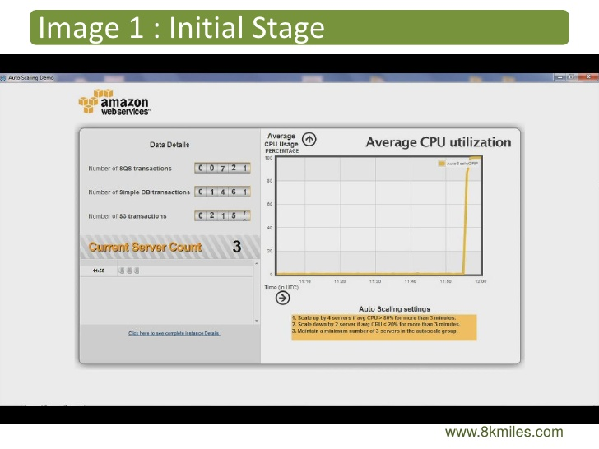

Slide 21
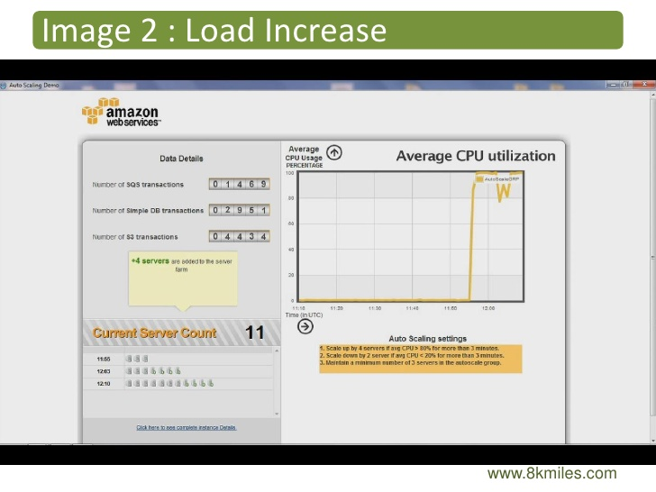

Slide 22
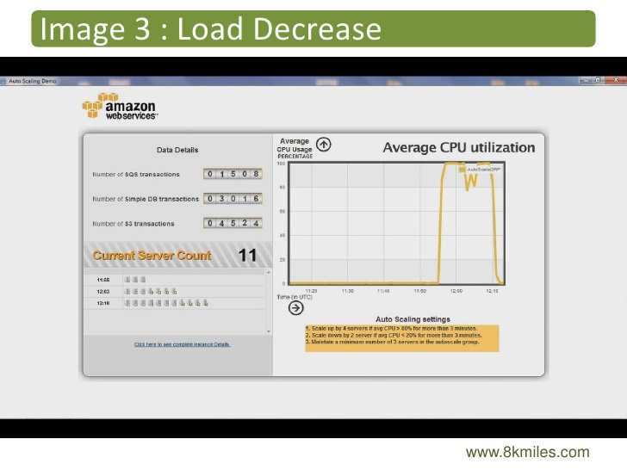

Slide 23
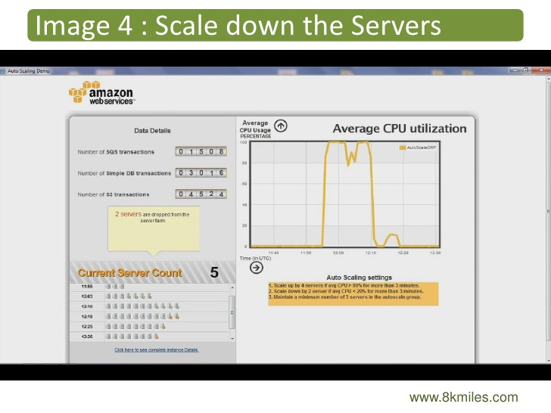

Slide 24
REAL TIME EXAMPLE
© 2018, Amazon Web Services, Inc. or its Affiliates. All rights reserved.

